Slide 1
Physics by Coding
Richard Taylor,
Merivale High School, Ottawa
Richard.Taylor@ocdsb.ca

Slide 2
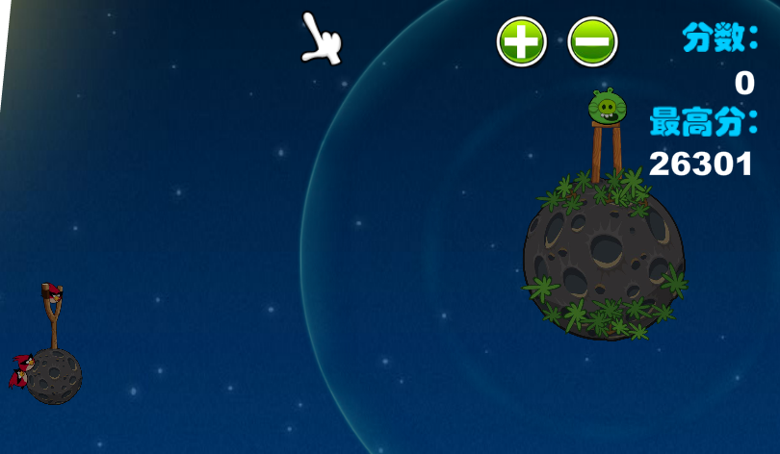
Problem:
There are lots of cool Physics simulations and games available on the Internet, but do students learn much Physics from them?

Slide 3
Hypothesis:
Students would learn more Physics if they actually coded the simulations themselves.

Slide 4
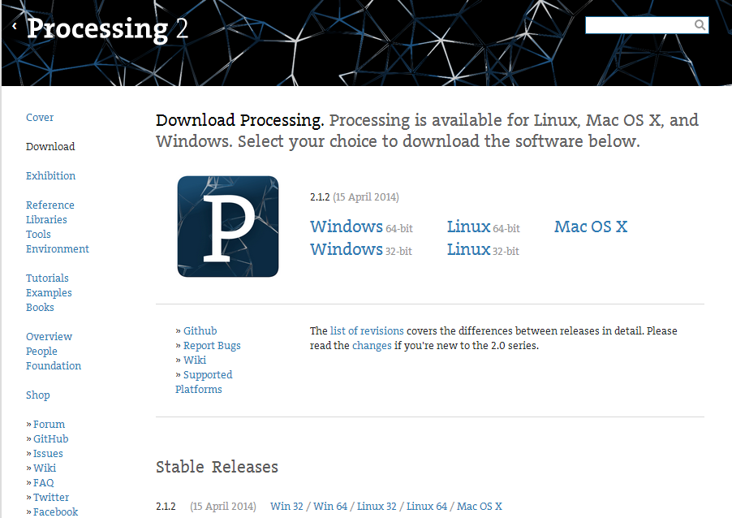
Materials: http://processing.org/

Slide 5
Procedure:
Survey students at beginning of semester to find background, initial capabilities and attitudes.
Introduce just enough programing lessons to get them started.
Give them a template to start from.
Substitute a few periods of coding in each unit in place of problem solving.

Slide 6
Procedure:
Web site of lessons:
https://sites.google.com/a/ocdsb.ca/physics-by-simulation/

Slide 7
Procedure: Physics template
//Basic template for Physics simulations, Richard P. Taylor 2011-12-06
Particle massA; //declare a particle object called massA
void setup() { //this function is for initialization tasks
size(640, 480); //create the display window, size in pixels
//create the previously declared object, giving initial values for position, velocity and mass
massA = new Particle(width/2, height/2, 1.0, 1.0, 10.0);
}
void draw() { //this function repeats endlessly to draw in the display window
background(0); //clear the display window to black
massA.move(); //tells the object to move to a new position
massA.display(); //tells the object to display itself in its new position
}

Slide 8
Procedure: Physics template
//object class definition for a basic particle, Richard P. Taylor 2012-12-06
//The particle has the properties of position, velocity and acceleration in two dimensions: x and y.
//It also has a mass.
class Particle { //here are all the sub-variables
float dx;
float dy;
float vx;
float vy;
float ax;
float ay;
float mass;

Slide 9
Procedure: Physics template
//When a Particle object is created, it must be passed initial values of x and y position, x and y //velocity and mass. These are passed in temporary variables that are then moved into the object's //properties. Acceleration is initialized as zero.
Particle(float tempX, float tempY, float tempVX, float tempVY, float tempMass) {
dx = tempX;
dy = tempY;
vx = tempVX;
vy = tempVY;
mass = tempMass;
ax = 0.0;
ay = 0.0;
}

Slide 10
Procedure: Physics template
//To move the particle, increment the velocity by the acceleration,
//then increment the position by the velocity
void move(){
vx = vx + ax;
vy = vy + ay;
dx = dx + vx;
dy = dy + vy;
}

Slide 11
Procedure: Physics template
//To display the particle, set the fill to white,
//then draw a circle at the current position with diameter equal to the mass
void display(){
fill(255);
ellipse(dx, dy, mass, mass);
}
} //end of object definition

Slide 12
Observations:
Survey results: Students were fairly evenly mixed. About half had previous programming courses and experience. They tended to use computers at several different levels - 4 used them less than one hour per day, 6 said several hours, 5 said as much as possible. 2 students started to bring laptops to class.

Slide 13
Observations and Analysis:
Initial introduction to programming was slow, and I made some mistakes in trying to introduce too many concepts at once. Eventually, I settled on having the students just add small modifications to the Physics Template. This enabled them to focus on the Physics rather than on the coding.

Slide 14
Observations and Analysis:
There is still some on-going confusion about declaring a variable, giving it an initial value and changing its value. Some of the confusion is associated with the variables that are part of a “particle object.” Next time, I will focus more of my introductory material on this concept.

Slide 15
Observations and Analysis:
Students’ ability to solve Physics problems on tests was similar to previous semesters. They were not disadvantaged by spending a significant amount of class time on programming.

Slide 16
Conclusion:
The experiment is not finished, and I don’t have an unambiguous way of finding out if students who code simulations understand Physics better than those who don’t.
I am satisfied that most of the students were able to produce working simulations that demonstrated Physics principles.

